Slide 1
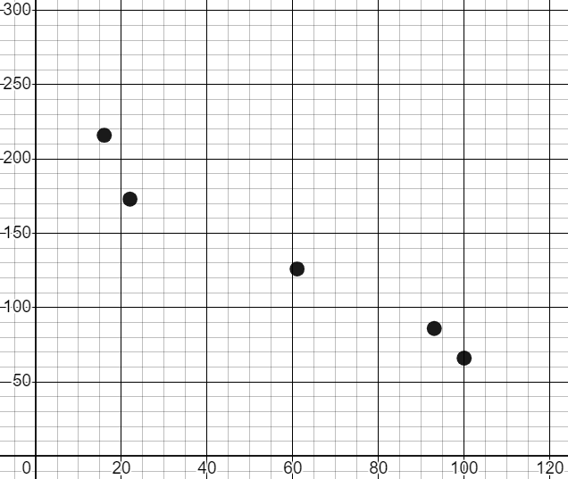
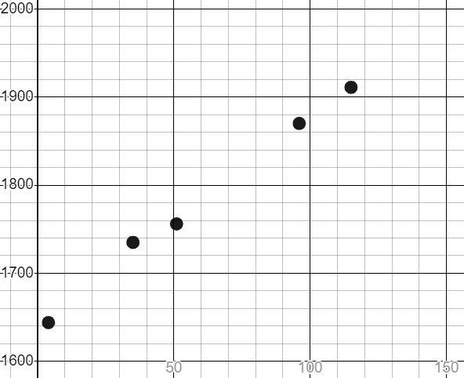
Constructing scatter graphs
Task A: Plotting bivariate data on a scatter graph
1) The table shows weather data from Bradford, for five months in 2021. Plot this data on a scatter graph.
Month | Total rainfall (mm) | Total sunshine (hours)
Feb | 100 | 66
Apr | 16 | 216
Jun | 22 | 173
Aug | 61 | 126
Oct | 93 | 86
total sunshine (hours)
total rainfall (mm)
2) Jacob runs a series of long-distance races. For each race, he records his time and the elevation (steepness) of the course. Plot Jacob’s data on the scatter graph.
elevation (m) | time (s)
51 | 1756
4 | 1644
35 | 1735
115 | 1911
96 | 1870
time (s)
elevation (m)

Slide 2
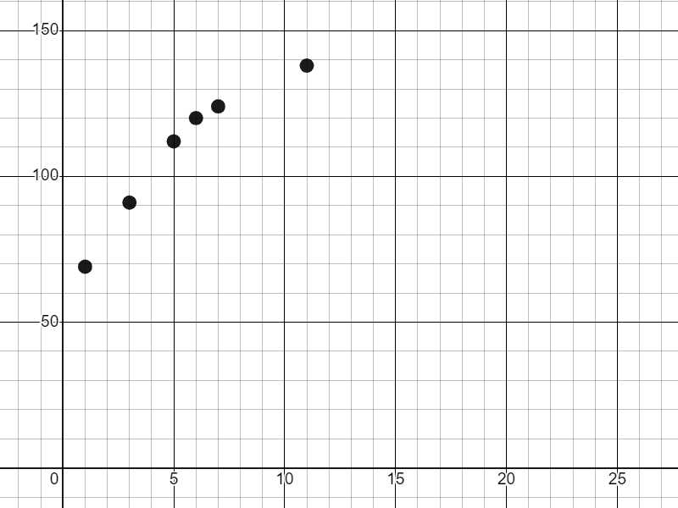
Constructing scatter graphs
Task B: Deciding which axis to use for each variable
1) For each pair of bivariate data, determine which is the independent variable and which is the dependent variable.
dependent
Example: ice cream sales maximum temperature of day
independent
independent
a) amount of water in a kettle (ml) time it take for the kettle to boil (s)
b) time it takes to complete a running course (s) steepness of the running course (m)
c) age of a child (years) height of the child (m)
d) number of floods reported in a month amount of rainfall in the month (mm)
dependent
dependent
independent
independent
dependent
dependent
independent
2) The data below shows the age and heights for a sample of six children. Plot the data on a scatter graph.
ages (years) | height (cm)
2 | 81
3 | 91
5 | 112
6 | 120
7 | 124
11 | 138
Mathematics in Education and Industry
v2.2

